Slide 1
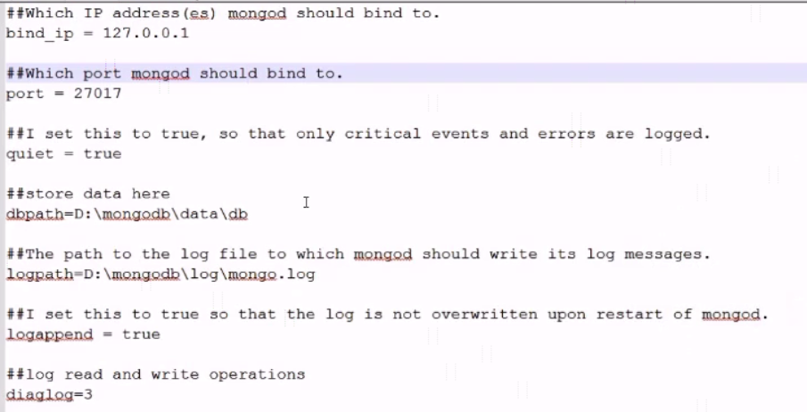
mongo.config
Configuring MongoDB server with configuration file

Slide 2
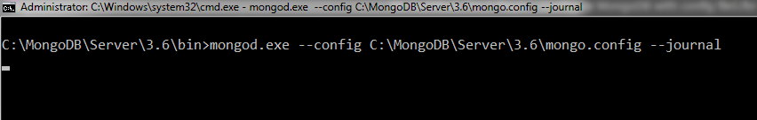
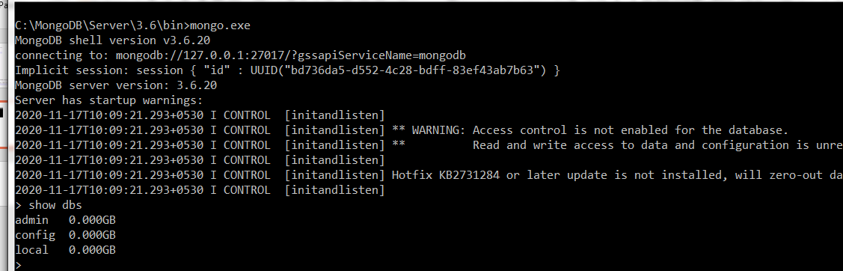
Configuring MongoDB server with configuration file
mongod.exe --config C:\MongoDB\Server\3.6\mongo.config --journal

